Slide 1

Unlocking the Power of SCNet-RLE Framework
Discover how the integration of SCNet and RLE can improve performance across different domains.
Songyi Zhao u7533680
Jiahong Sun u7551207
Zhengyu Chen u7531371

Slide 2

Introduction
The topic
The importance
Our aims
Our research tackles the challenge of accurate pose estimation, which is pivotal in understanding and interpreting human gestures and movements through computer vision.
The significance of accurate pose estimation cannot be overstated—it powers advancements in augmented reality, enriches interactive gaming, enhances sports analytics, and is vital for patient monitoring in healthcare. Its versatility across industries makes it not just fascinating but essential.
Our goal is to create a framework that excels in real-time, accurate human pose estimation.

Slide 3
Related
Heatmap-based
Regression-based
SCNet-RLE
High accuracy
Efficient
We propose SCNet-RLE, a novel framework that merges the Self-Calibrated Convolutions (SCC) from SCNet with the Residual Log-likelihood Estimation (RLE), aiming to enhance the accuracy of regression-based pose estima- tion while maintaining computational efficiency.
But
But
High computation
Less accurate

Slide 4
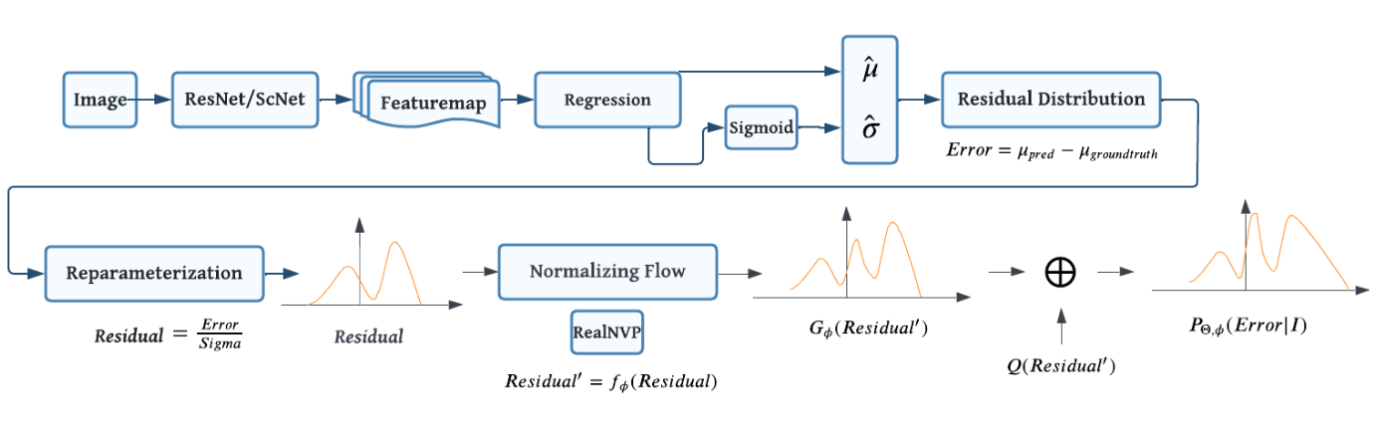
Our Framework

Slide 5
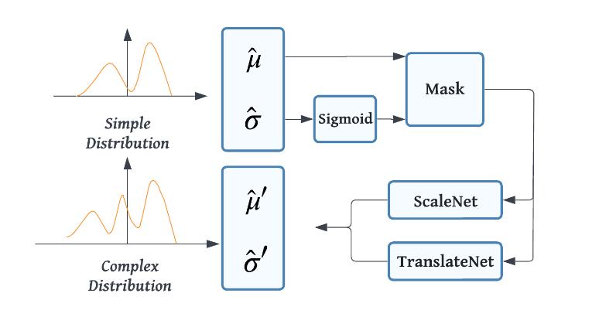
Normalizing Flow

Slide 6
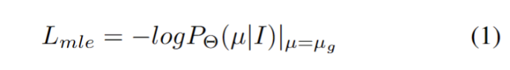
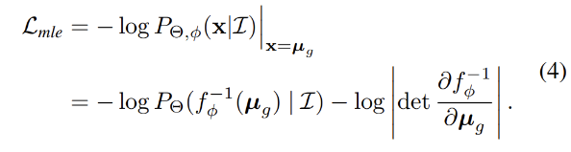
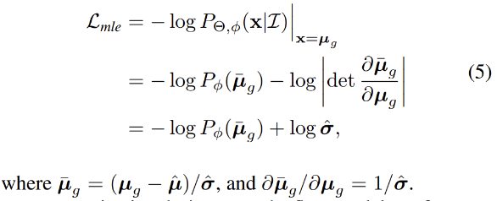
Problem Statement I
Evaluate the pose estimation task in the perspective of maximum likelihood estimation (MLE)
General Regression
Regression With Normalizing Flow (Distribution)
Regression With Normalizing Flow (Residual)

Slide 7
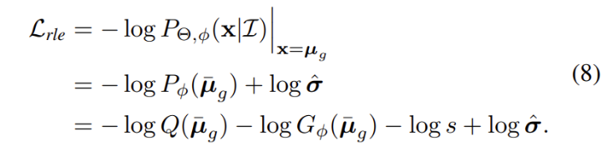
Problem Statement II
Regression With Normalizing Flow (Gradient Shortcut)
Benefit
Residual probability distributions:
Better quantification of uncertainty.
Normalizing Flow:
Allow model to explicitly modeling the distribution.
Better understanding of model.

Slide 8

Existing Methods Comparison
1
Baseline Method
DeepPose is an early deep learning approach for human pose estimation that employs convolutional neural networks to predict joint coordinates from images.
2
State of the Art
Dense Object Nets: Fast Object Detection in Large Cluttered Scenes, the current state-of-the-art.
3
SCNet-RLE Framework
The proposed method shows significant improvements in performance compared to both the Baseline Method and Dense Object Nets.

Slide 9
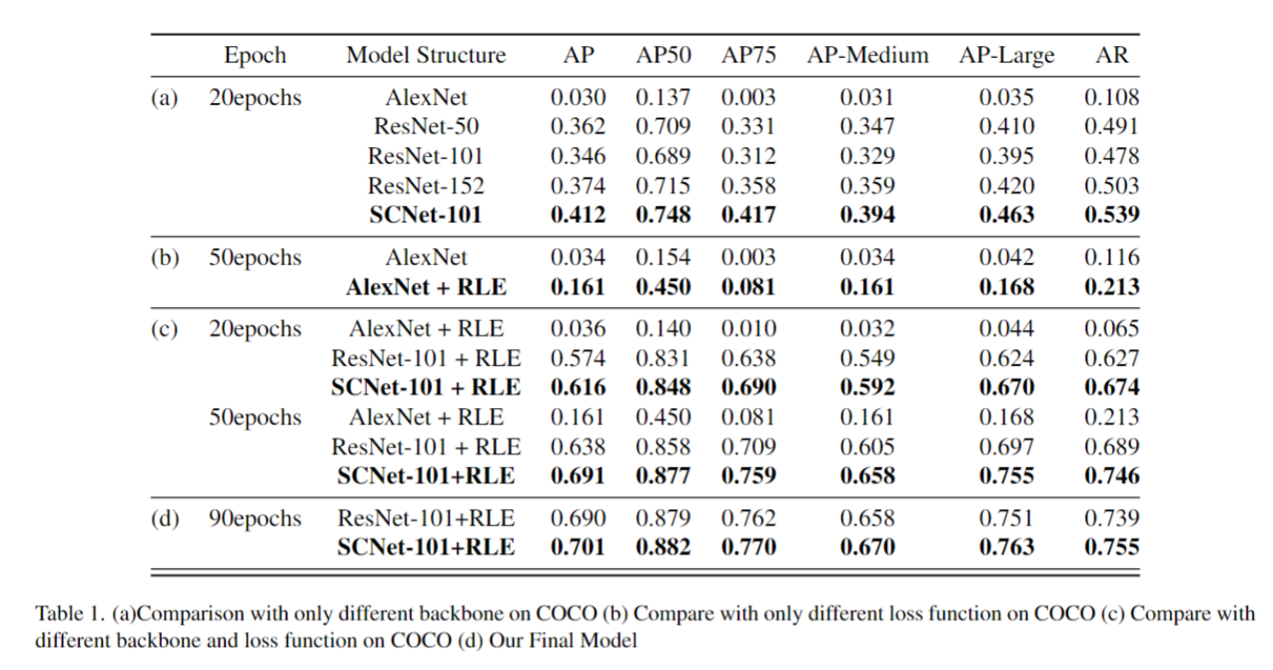
Experimental Results

Slide 10
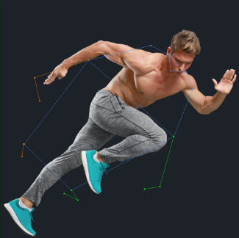

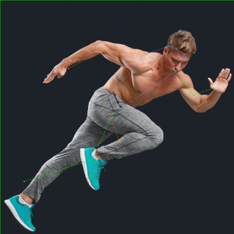

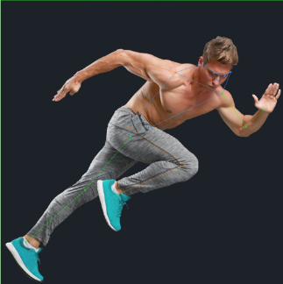
Experimental Visulization
AlexNet AlexNet+RLELoss Resnet
SCNet SCNet+RLELoss

Slide 11

Discussion of Experimental Findings
1
Generalization and Interpretability
2
Performance Improvement
3
Future Directions
The framework has great potential in predicting more complex objects and categories in addition to the urban scenes depicted in these experiments.
SCNet-RLE framework's multi heads architecture allows the integration of these models, offering more robust feature representation and improving generalization and outlier detection.
The proposed SCNet-RLE method outperformed other state-of-the-art object detection techniques in terms of both AP and IoU metrics.

Slide 12

Future Work
In the context of the RLE loss function, we want to modify the loss function to better capture the distribution shape. We can introduce an additional loss term specifically designed to penalise prediction error for tail events.
For a concrete implementation, we will need to define these new loss terms and decide how to integrate them into the existing framework.

